Slide 1

NEXT
Pick Up Your Next Game
Faisal Hossain | All Star Code Benefit

Slide 2
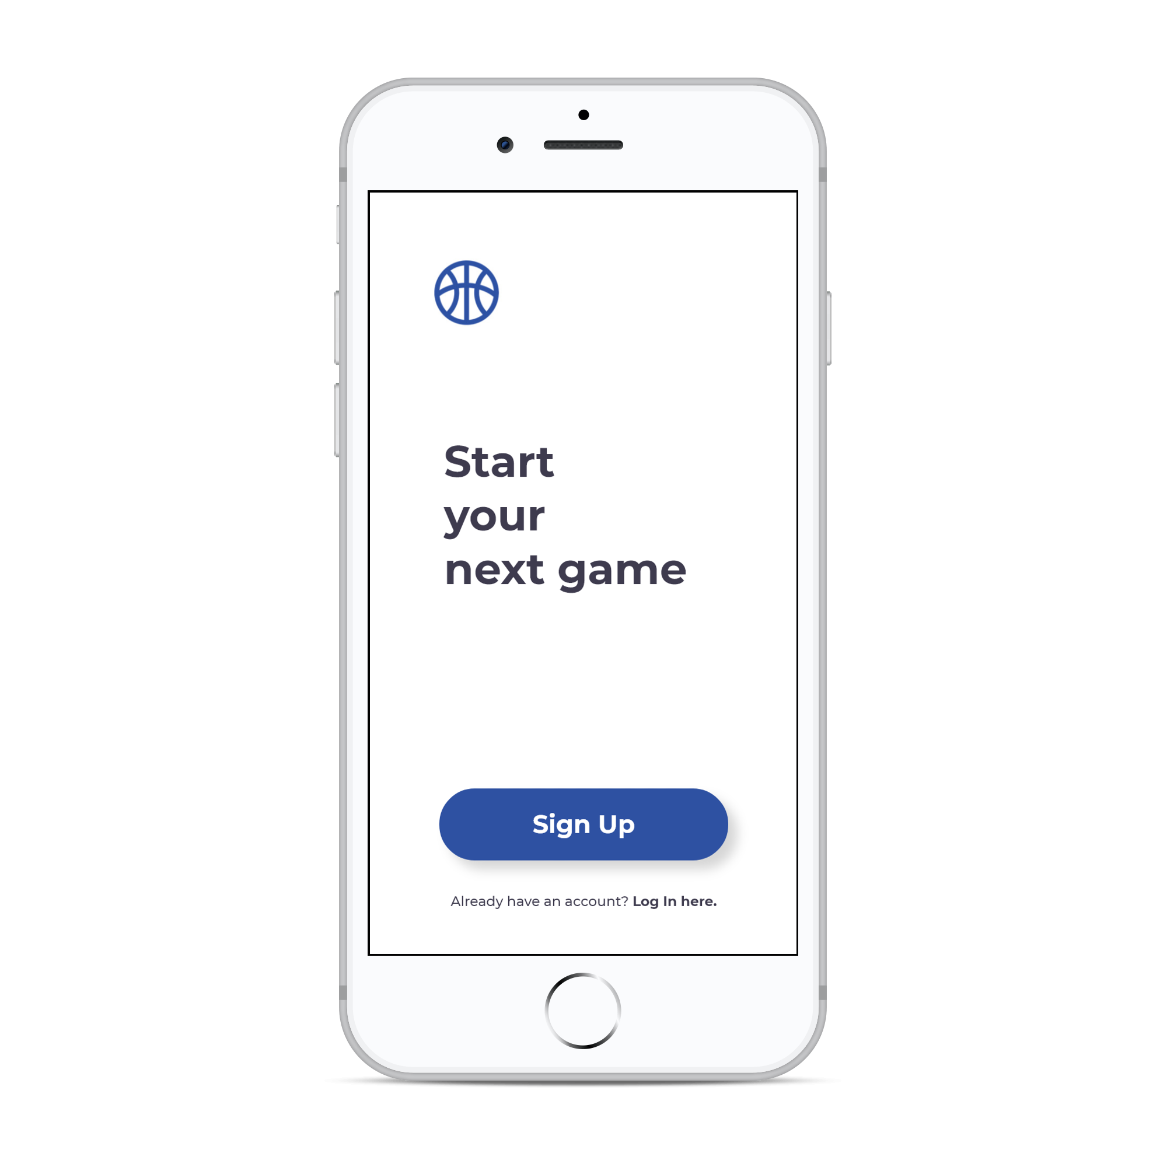
// NEXT
Don’t wait to play next!
NEXT is an innovative way to pick up nearby basketball games without wasting any time. Designed to call next before even stepping foot on the court.

Slide 3

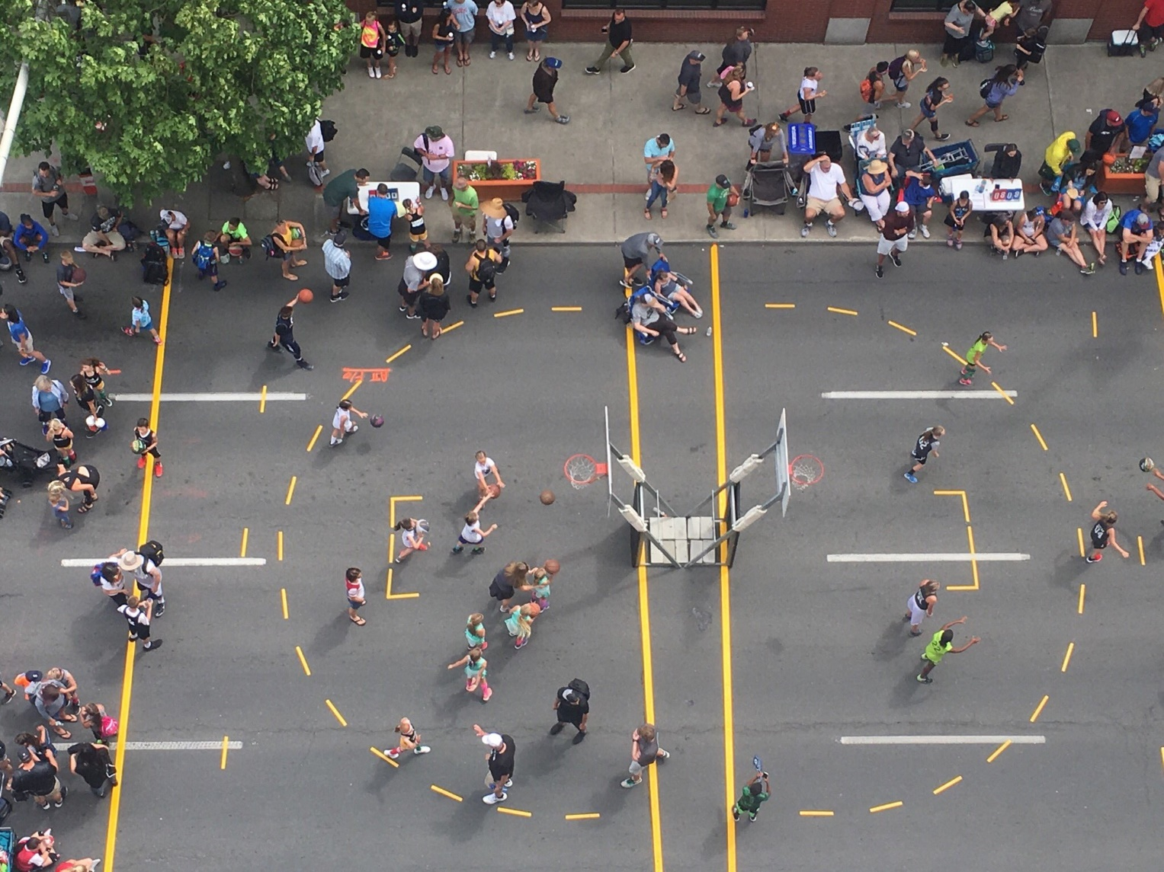
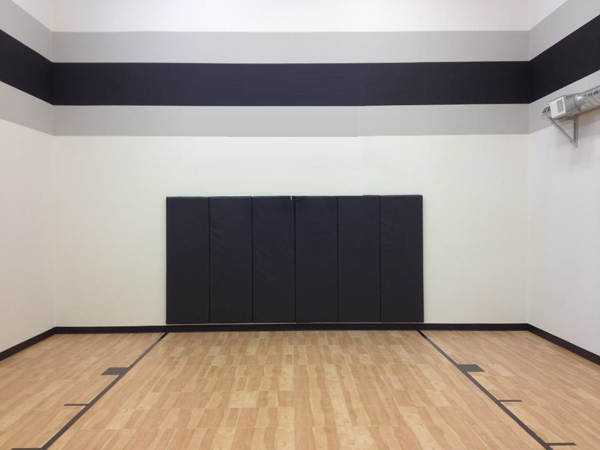








// NEXT
Problems
Unknown Courts
A common issue both natives and visitors of a region face while looking a game is finding all available basketball courts nearby.
Packed Courts
After finding a nearby court, it is maddening to find the court is packed. Or going to a court that does not fit your age/height group. Or even going go to a court booked for an event.
Time Wasted
Above all, the most annoying of them all is wasting time; whether it is riding the musty train to find out that the court is packed, or waiting centuries to pickup for the next game.

Slide 4
Over 26 Million Americans Play Basketball
On Average players wait 10 to 25 MINUTES play next
1 out of 14 Americans Play Basketball
* Sources | New York Post, SFIA.org, Court Survey

Slide 5
// NEXT
Solutions

Slide 6
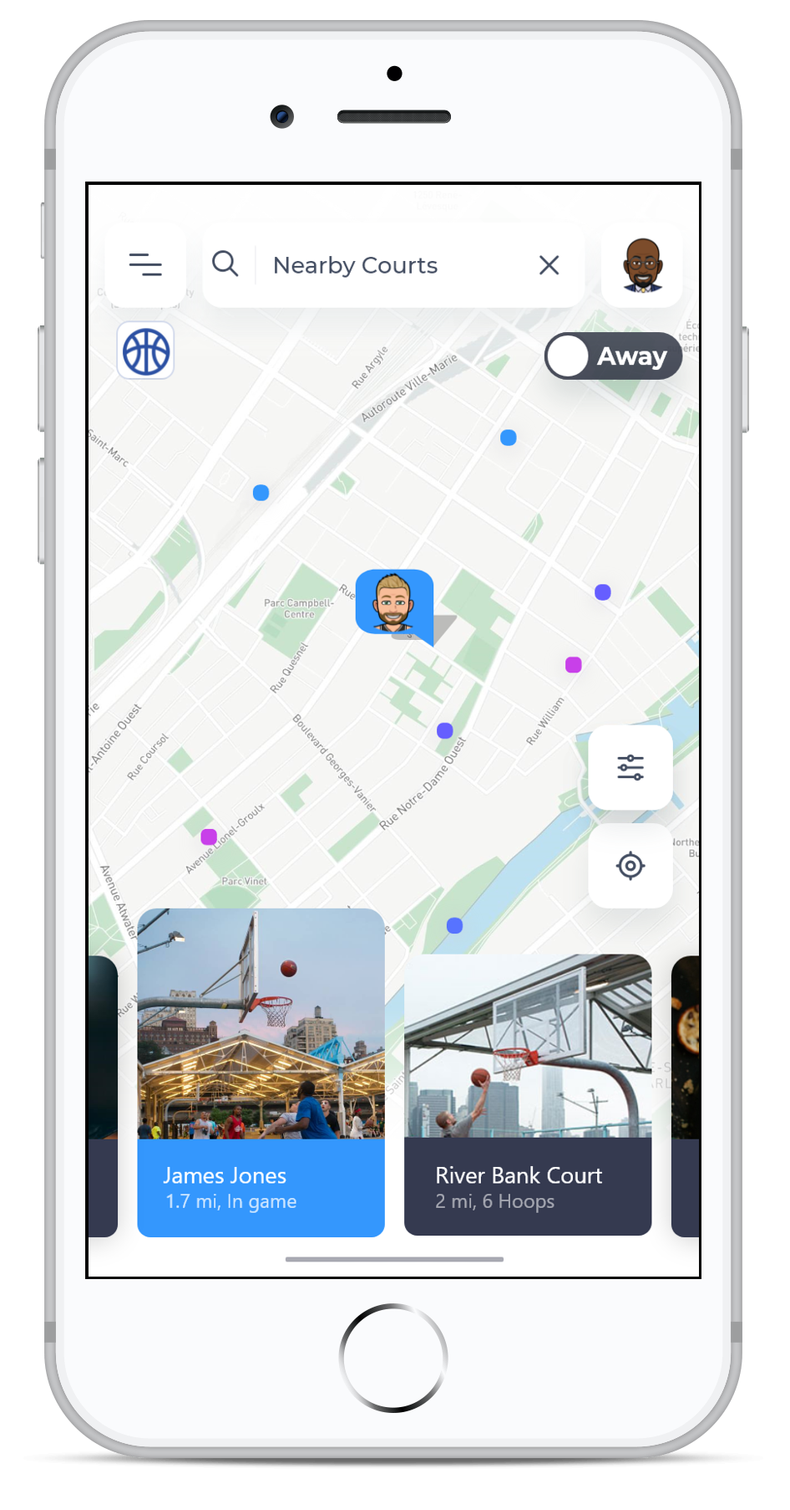
// NEXT
Interactive
Map
Find basketball courts at your fingertips. NEXT’s interactive map allows users to expand their radius by exploring new basketball courts. Additionally, the interactive maps allows users to check for friends nearby that ready to play a game.

Slide 7
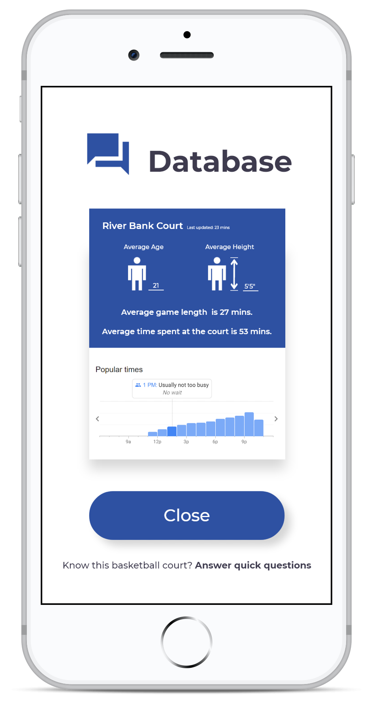
// NEXT
Real Time
Database
Know the competition before even stepping foot on the court with NEXT. Games tend to turn out to be too difficult or even too easy due to differing ages and heights. NEXT provides real time data to assist users of making the decision like whether they really want play against someone 2 feet taller than them or save users time by warning them of packed courts.

Slide 8
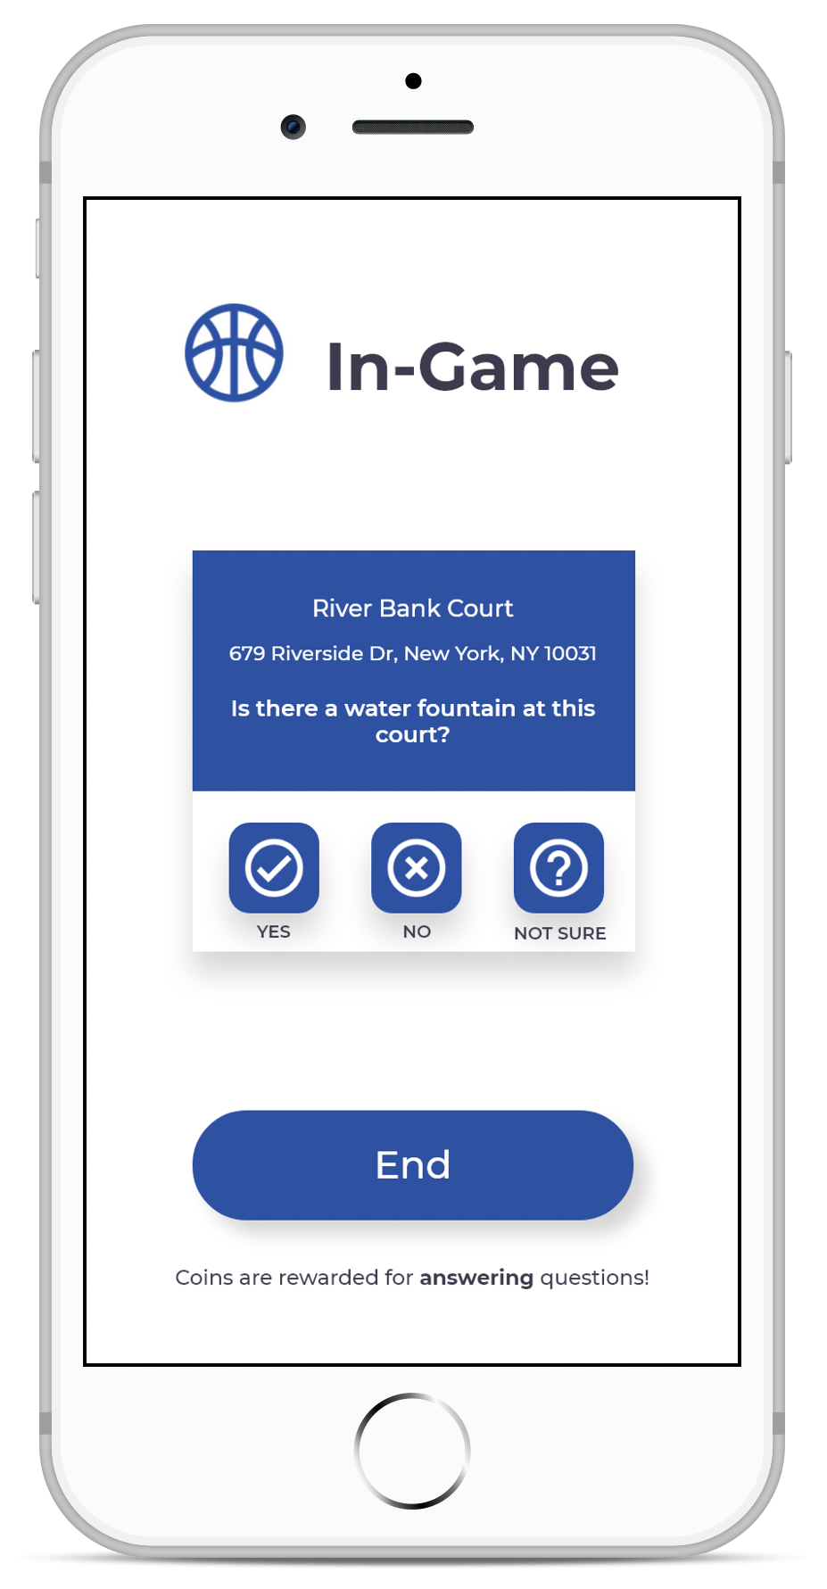
// NEXT
Real Time
Database - 2
NEXT databases are powered by the users and artificial intelligence. Users are incentivized in providing beneficial real time court data with in-app currency. NEXT utilizes artificial intelligence to provide useful information, such as the average time spent at a basketball court. Additionally, cooperating private gyms and basketball courts can further assist in providing information.

Slide 9
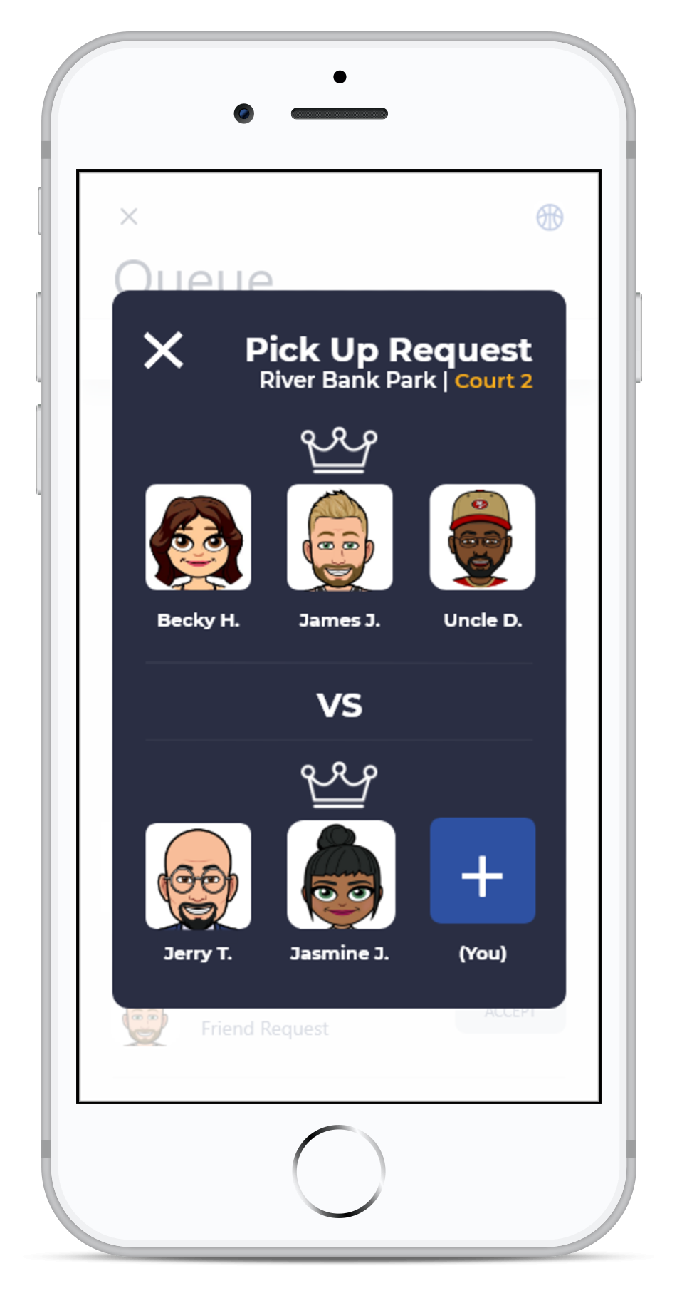
// NEXT
Queueing
System
By simply accepting an invitation to pick up a game or creating a match with our user-friendly User Interface (UI), players can be playing a game within seconds. Not only does the feature save time by having a team ready before getting on the court, it eliminates the need to look for player willing to play as the app displays ‘Ready’ players when creating a game.

Slide 10
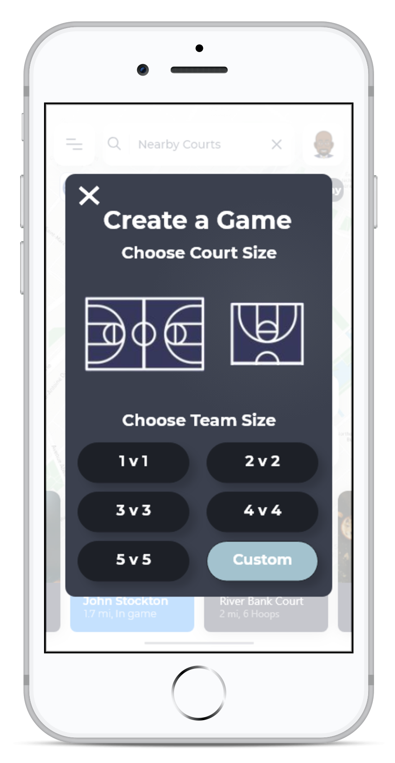
// NEXT
Queueing
System - 2
By simply accepting an invitation to pick up a game or creating a match with our user-friendly User Interface (UI), players can be playing a game within seconds. Not only does the feature save time by having a team ready before getting on the court, it eliminates the need to look for player willing to play as the app displays ‘Ready’ players when creating a game.

Slide 11
// NEXT
Additional Features

Slide 12
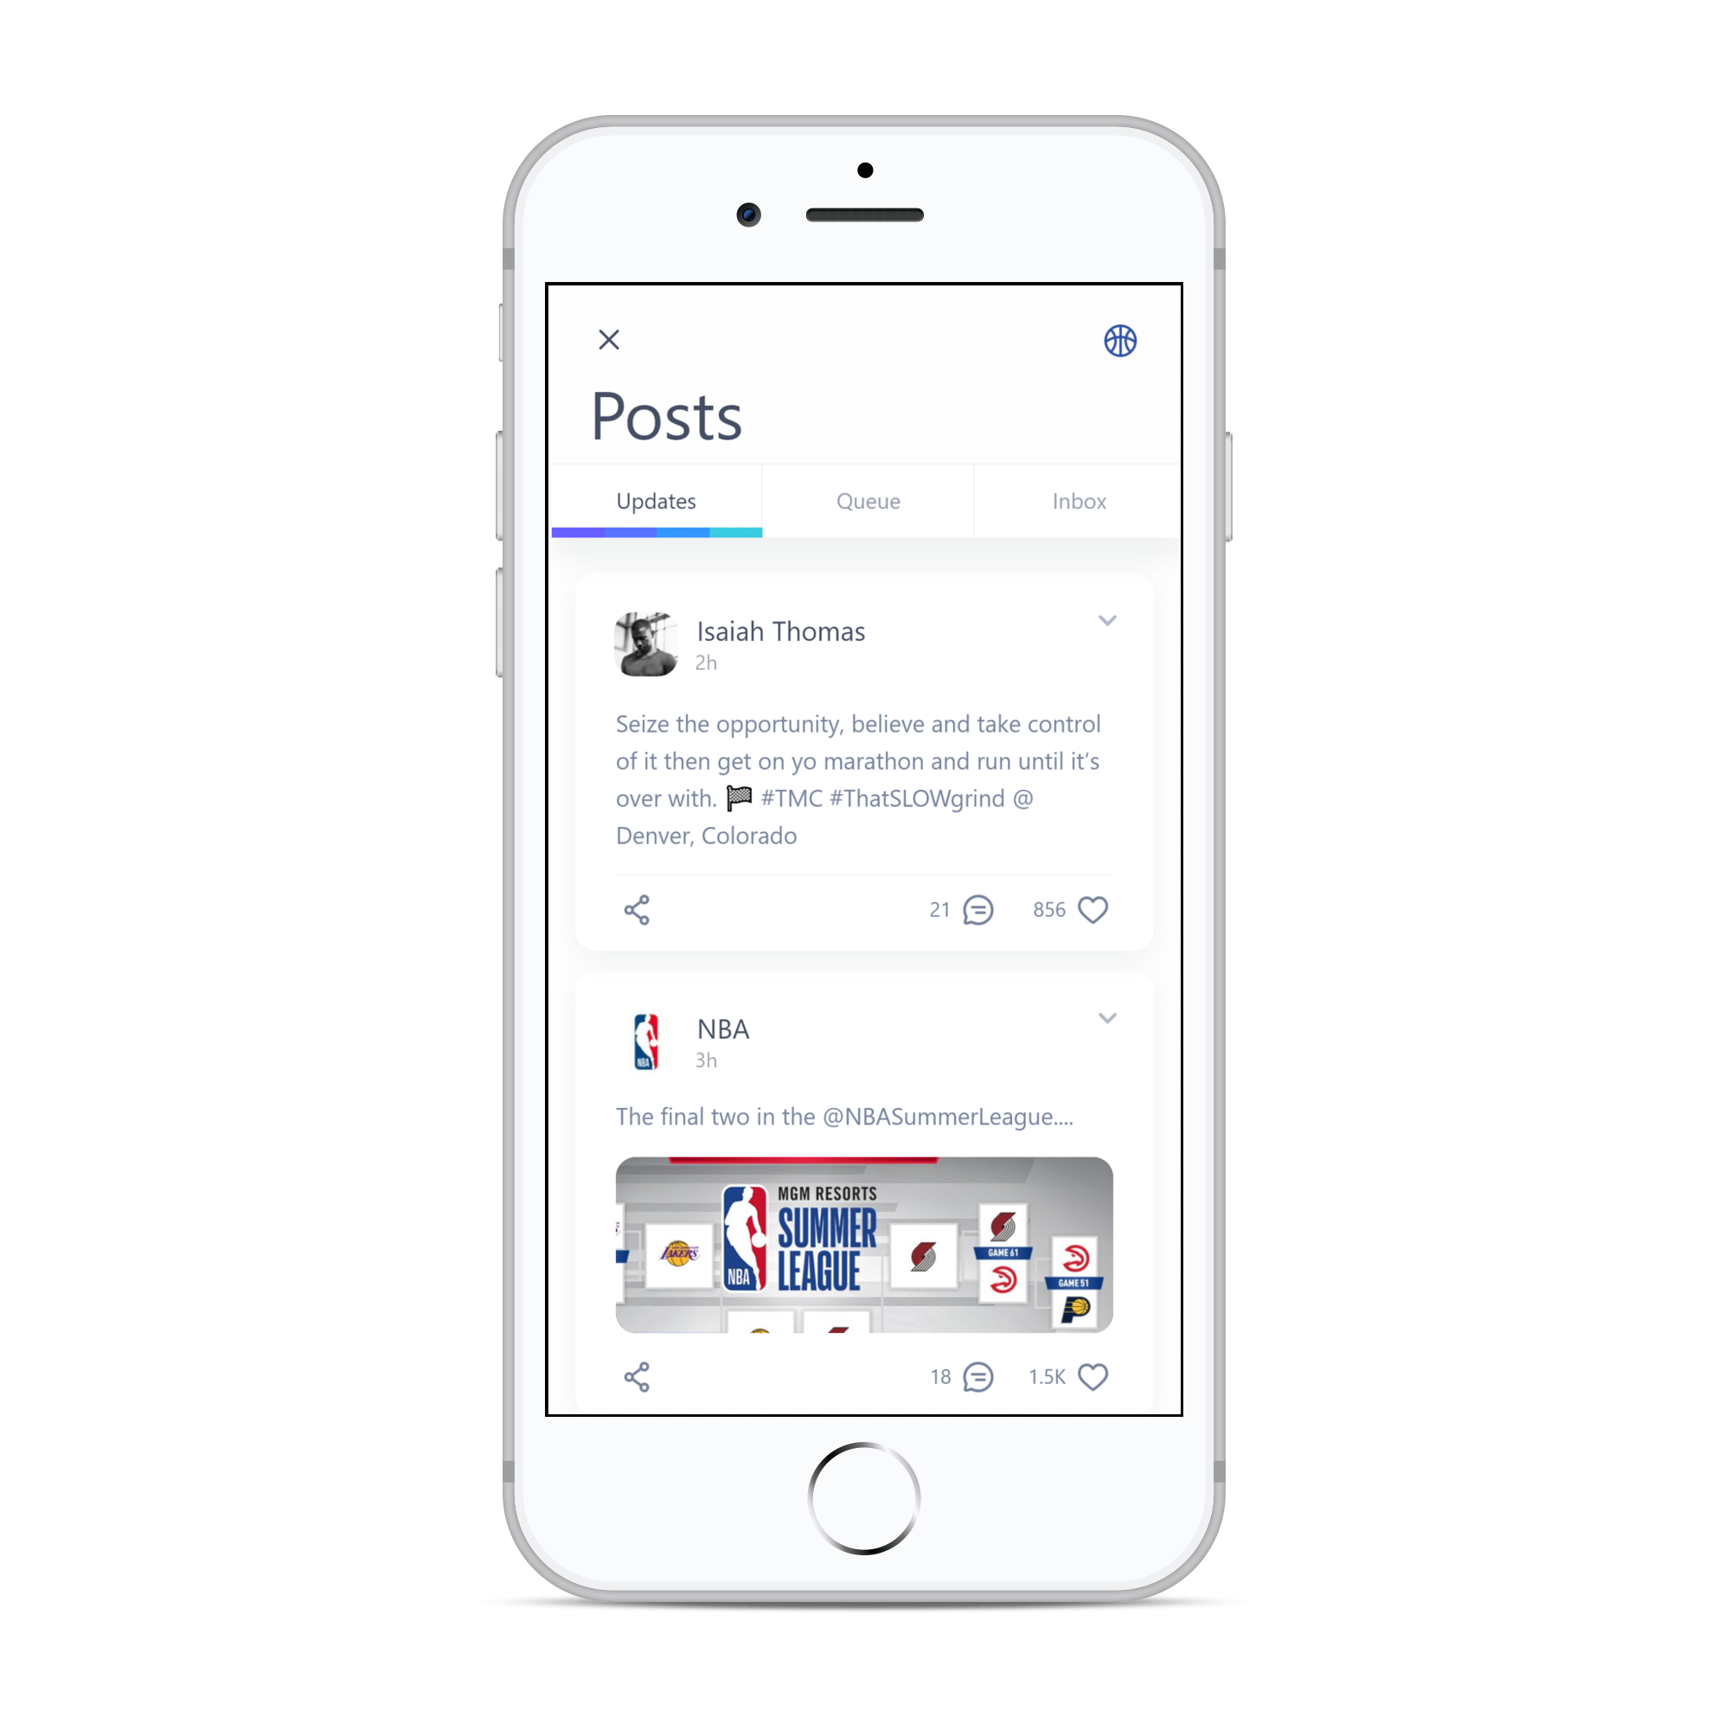

Live Basketball Updates
Instant Messaging
Stay updated with NEXT’s live feed. Live feed consists of posts from various professional basketball associations’, organizations’, and players’ social media.
A built-in instant messaging service allows users to communicate with friends easily without ever having to leave the app.
Navigation
Custom Avatar
Navigate from home, work, or wherever using NEXT’s built-in navigation service; allowing users to navigate to basketball courts without ever leaving the app.
NEXT allows users to create a personal avatar that is displayed when meeting and playing with other players. Avatars are fully customizable from eye colors to the color of their jersey.

Slide 13
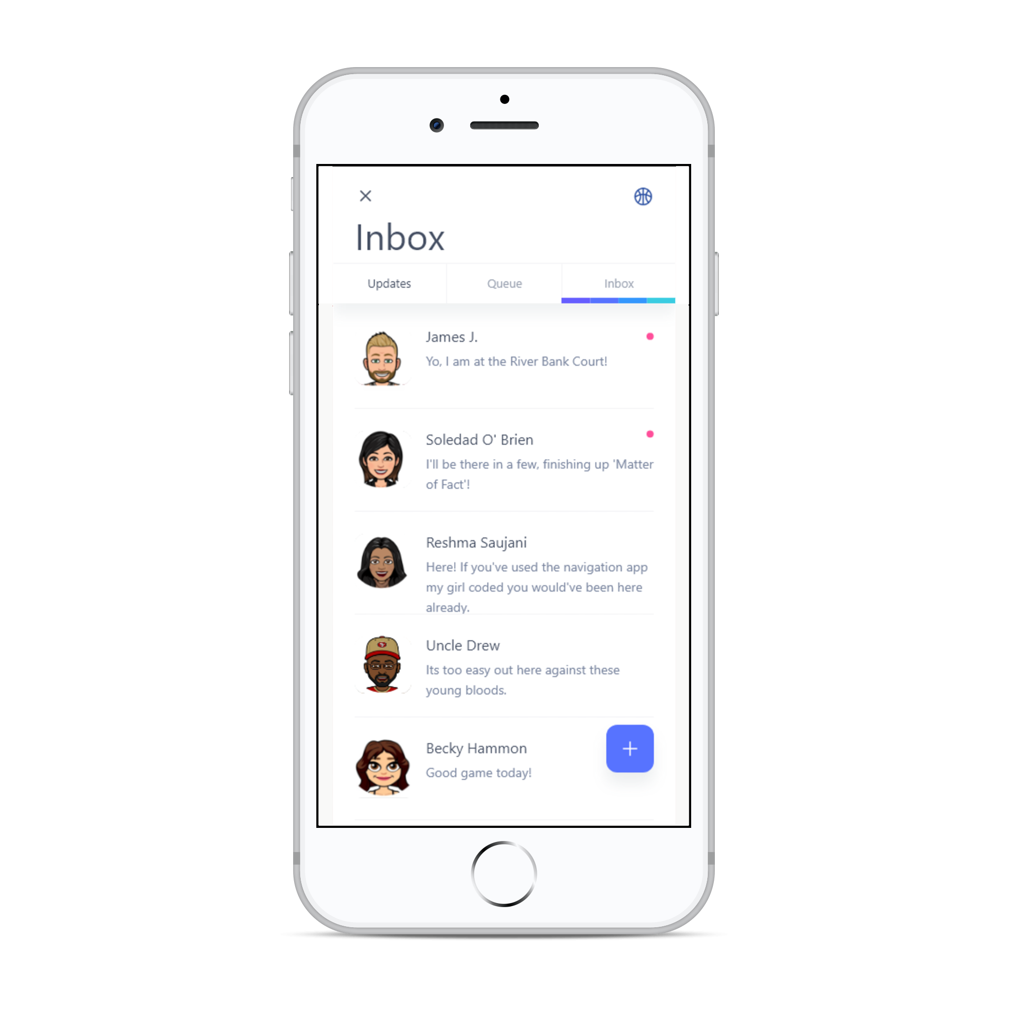
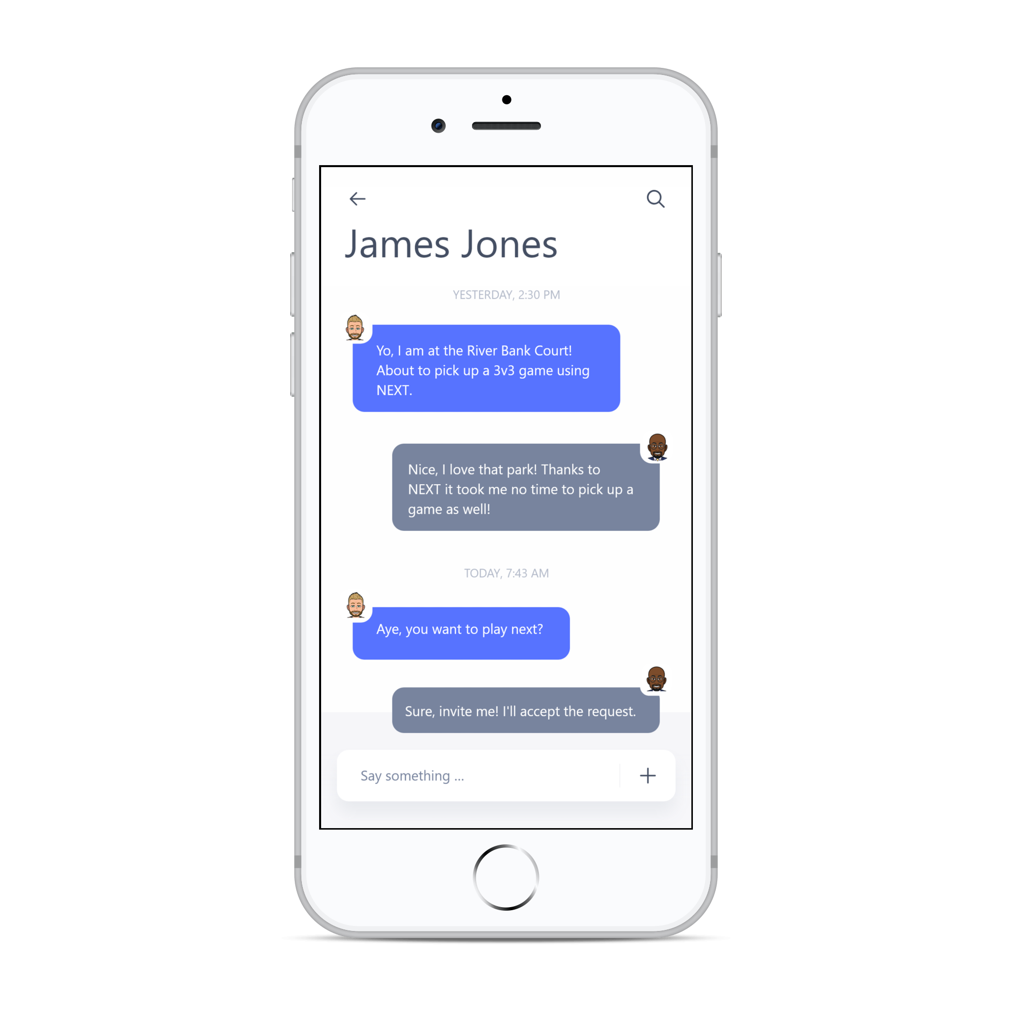
Live Basketball Updates
Instant Messaging
Stay updated with NEXT’s live feed. Live feed consists of posts from various professional basketball associations’, organizations’, and players’ social media.
A built-in instant messaging service allows users to communicate with friends easily without ever having to leave the app.
Navigation
Custom Avatar
Navigate from home, work, or wherever using NEXT’s built-in navigation service; allowing users to navigate to basketball courts without ever leaving the app.
NEXT allows users to create a personal avatar that is displayed when meeting and playing with other players. Avatars are fully customizable from eye colors to the color of their jersey.

Slide 14
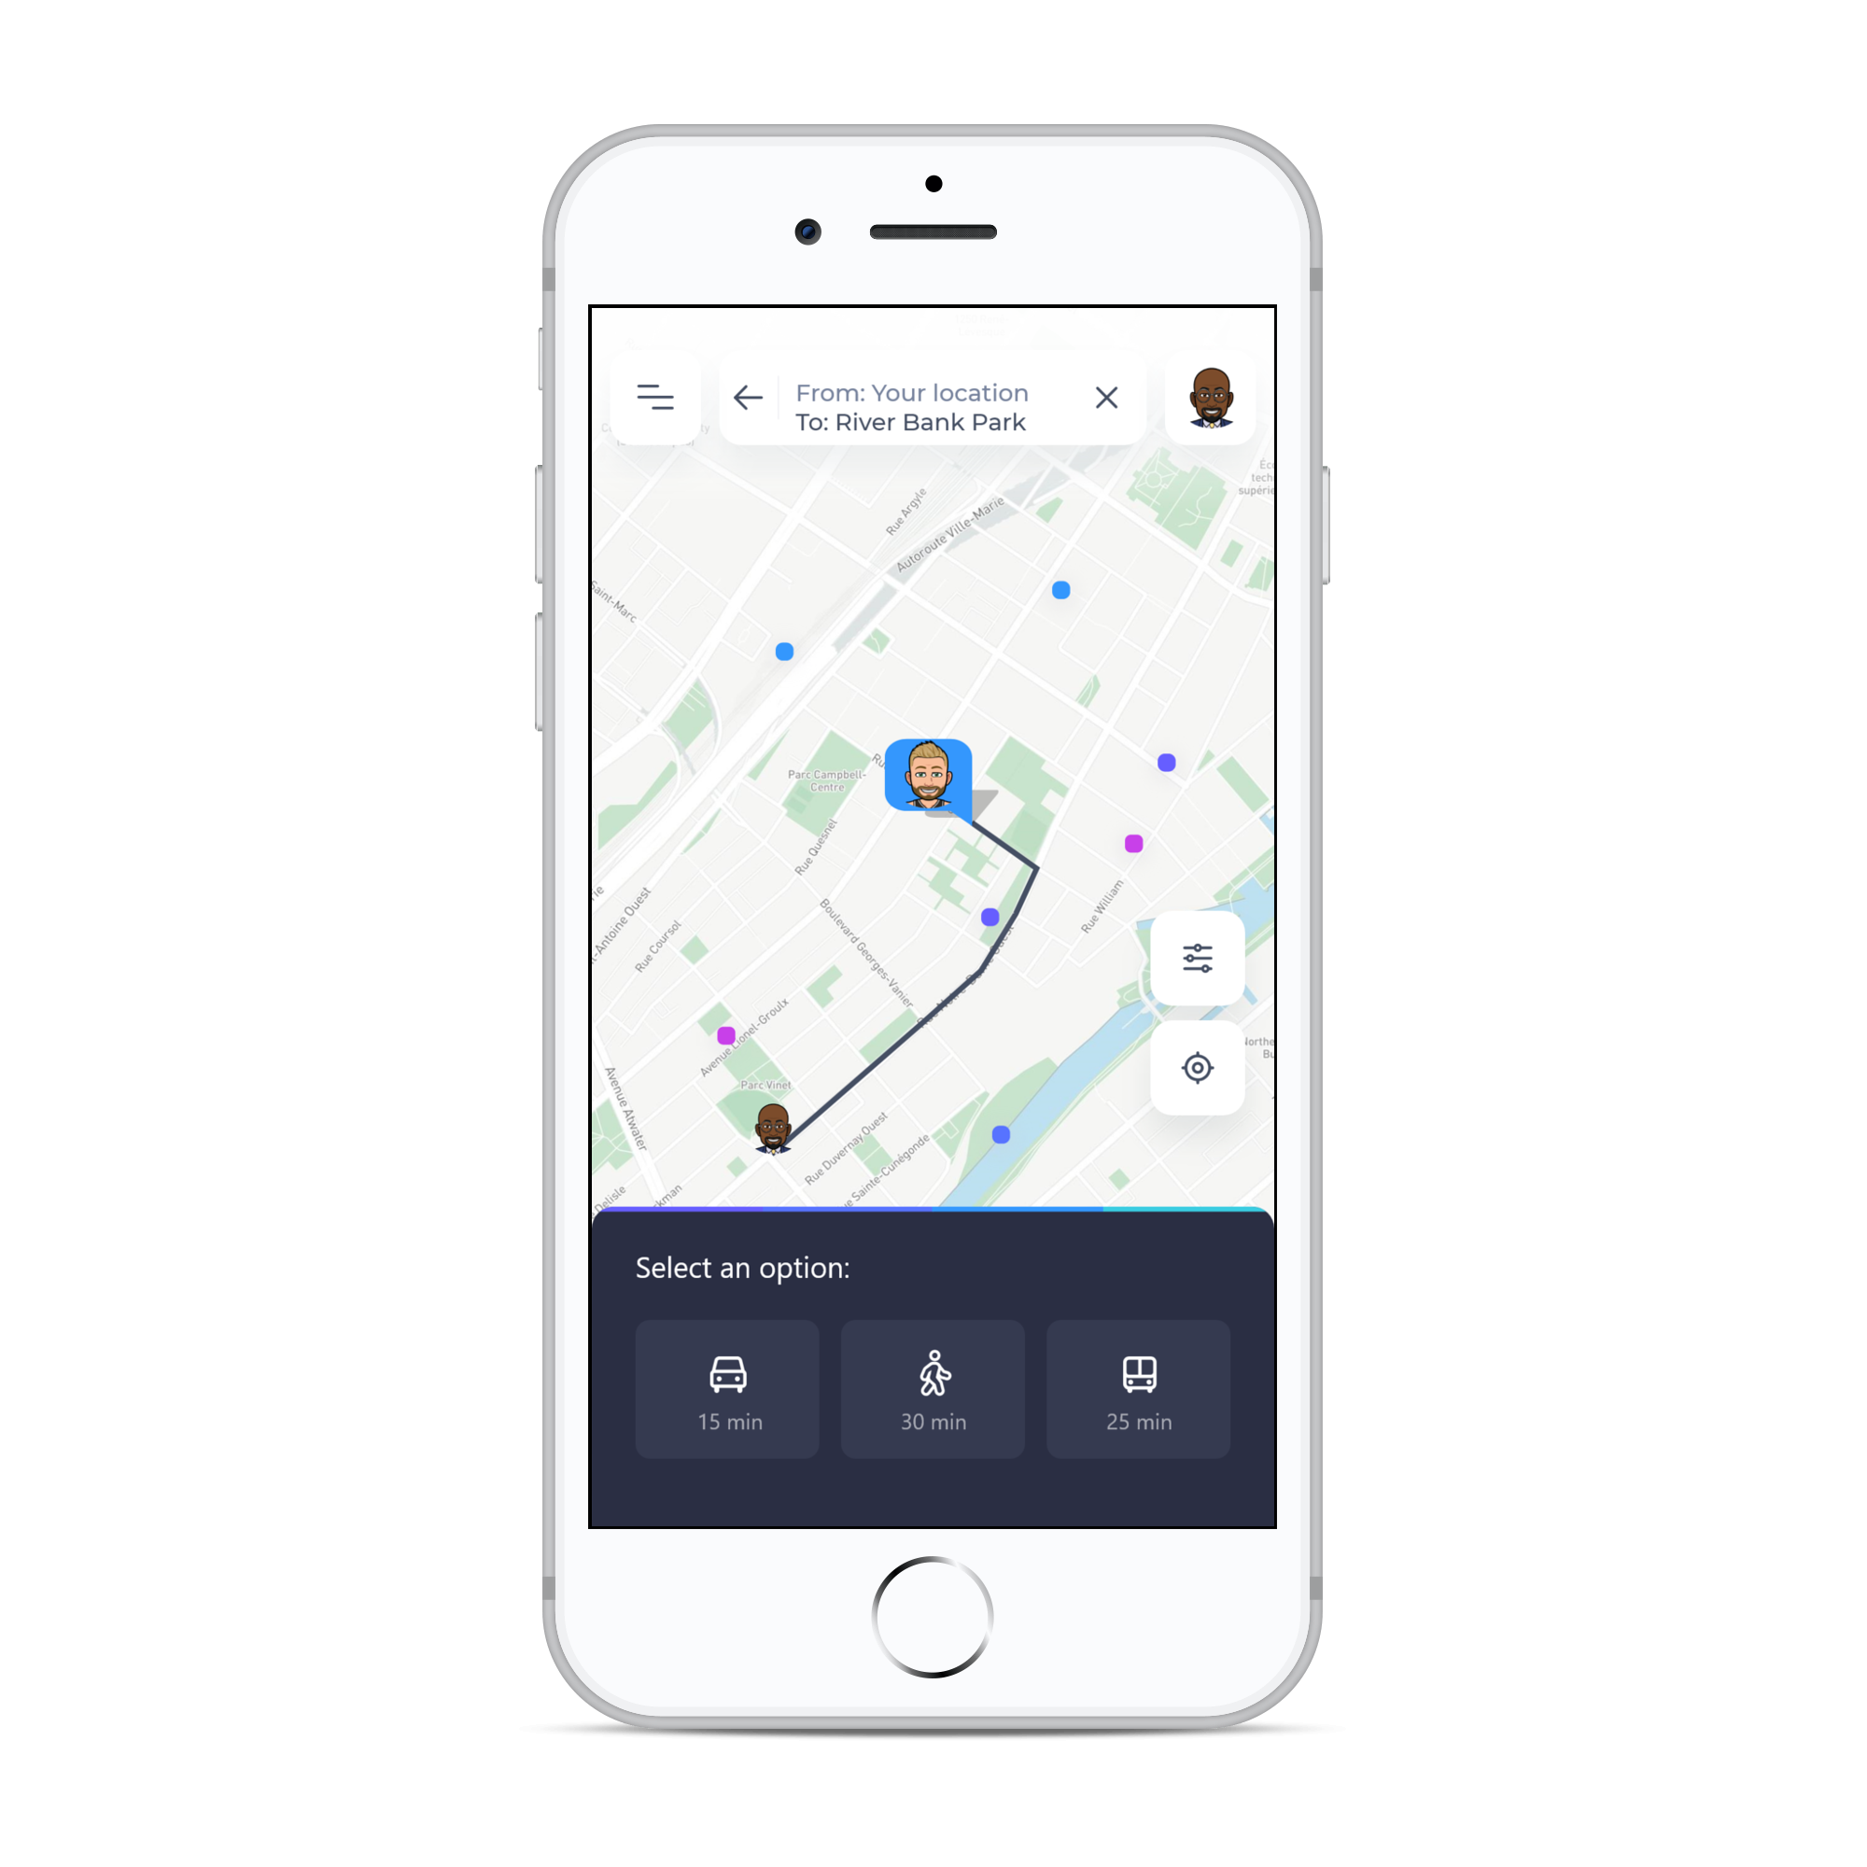
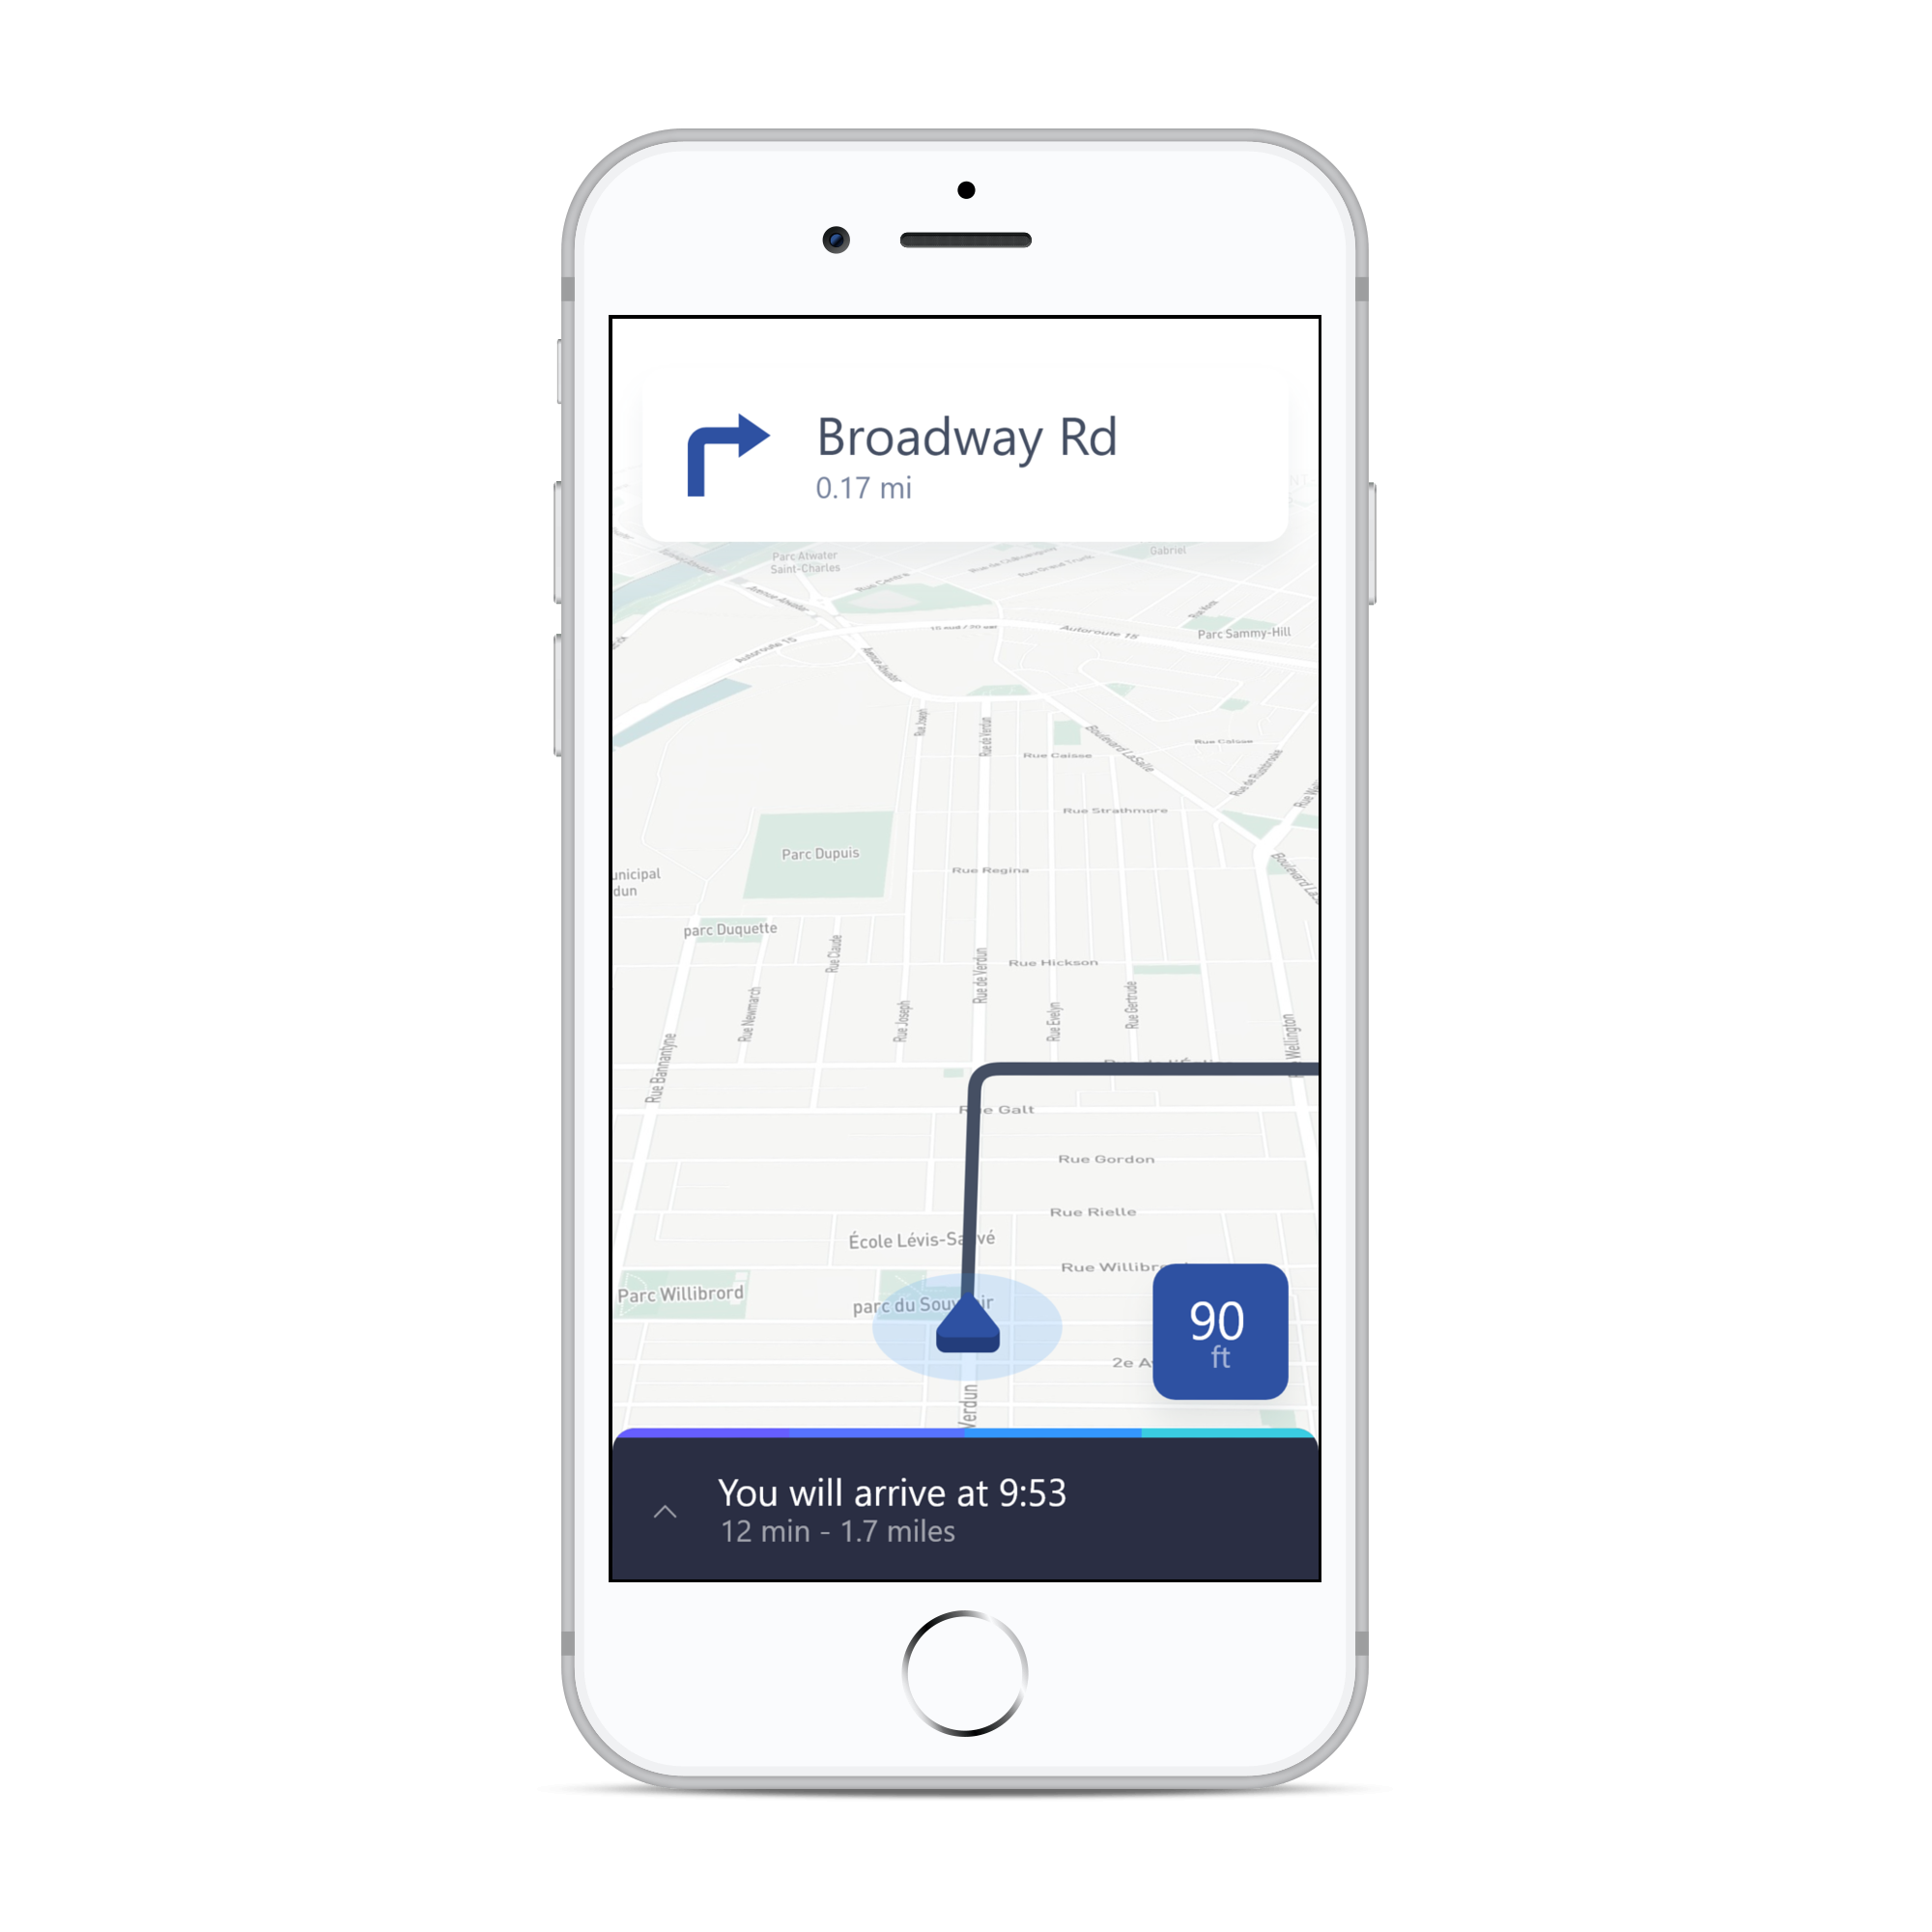
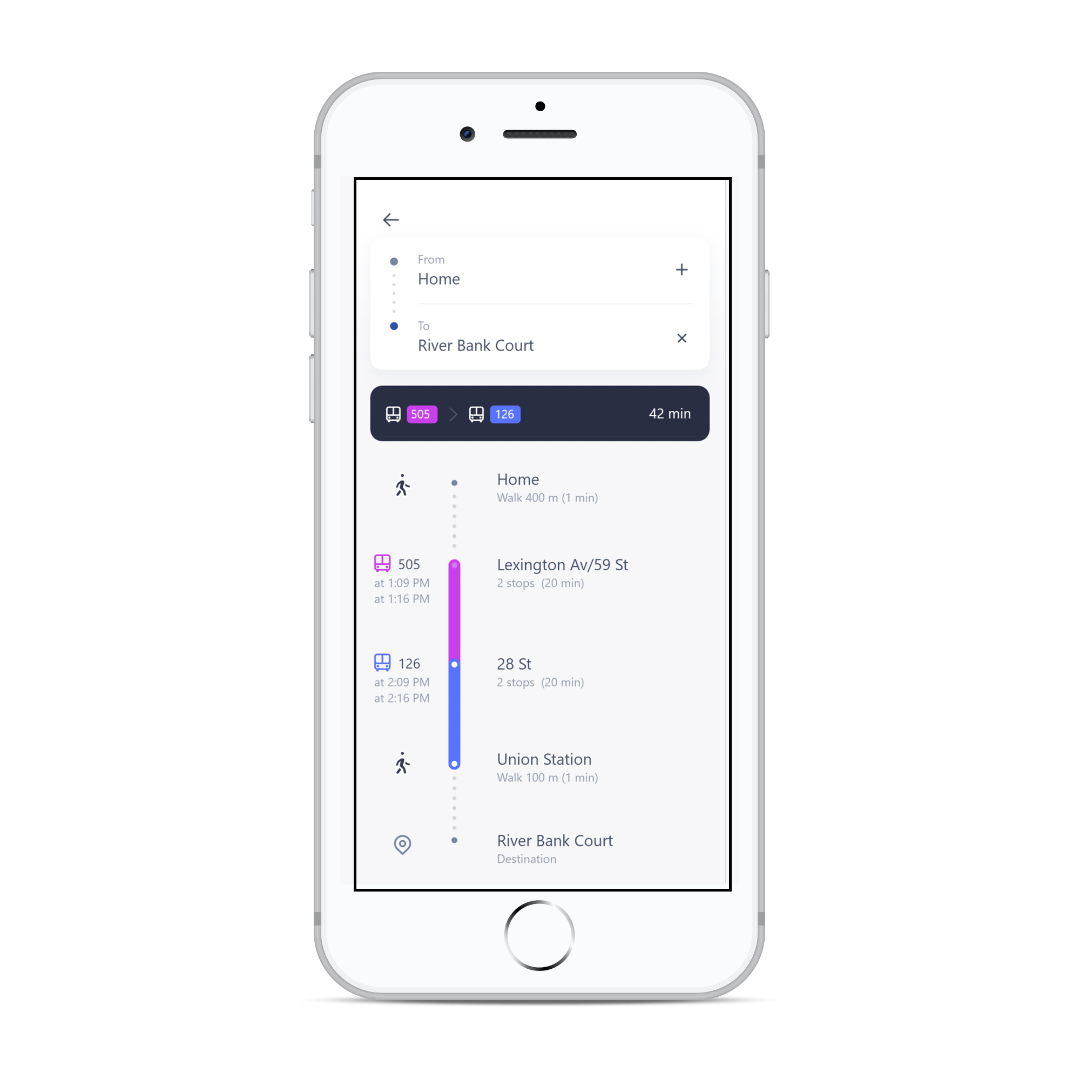
Live Basketball Updates
Instant Messaging
Stay updated with NEXT’s live feed. Live feed consists of posts from various professional basketball associations’, organizations’, and players’ social media.
A built-in instant messaging service allows users to communicate with friends easily without ever having to leave the app.
Navigation
Custom Avatar
Navigate from home, work, or wherever using NEXT’s built-in navigation service; allowing users to navigate to basketball courts without ever leaving the app.
NEXT allows users to create a personal avatar that is displayed when meeting and playing with other players. Avatars are fully customizable from eye colors to the color of their jersey.

Slide 15
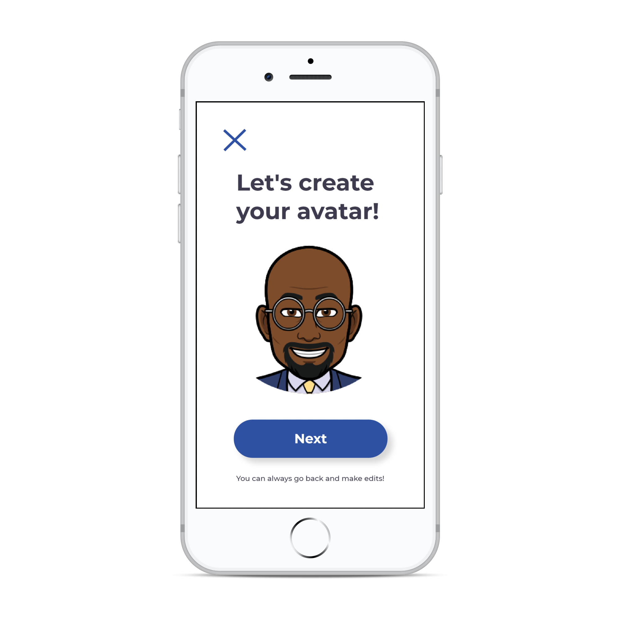
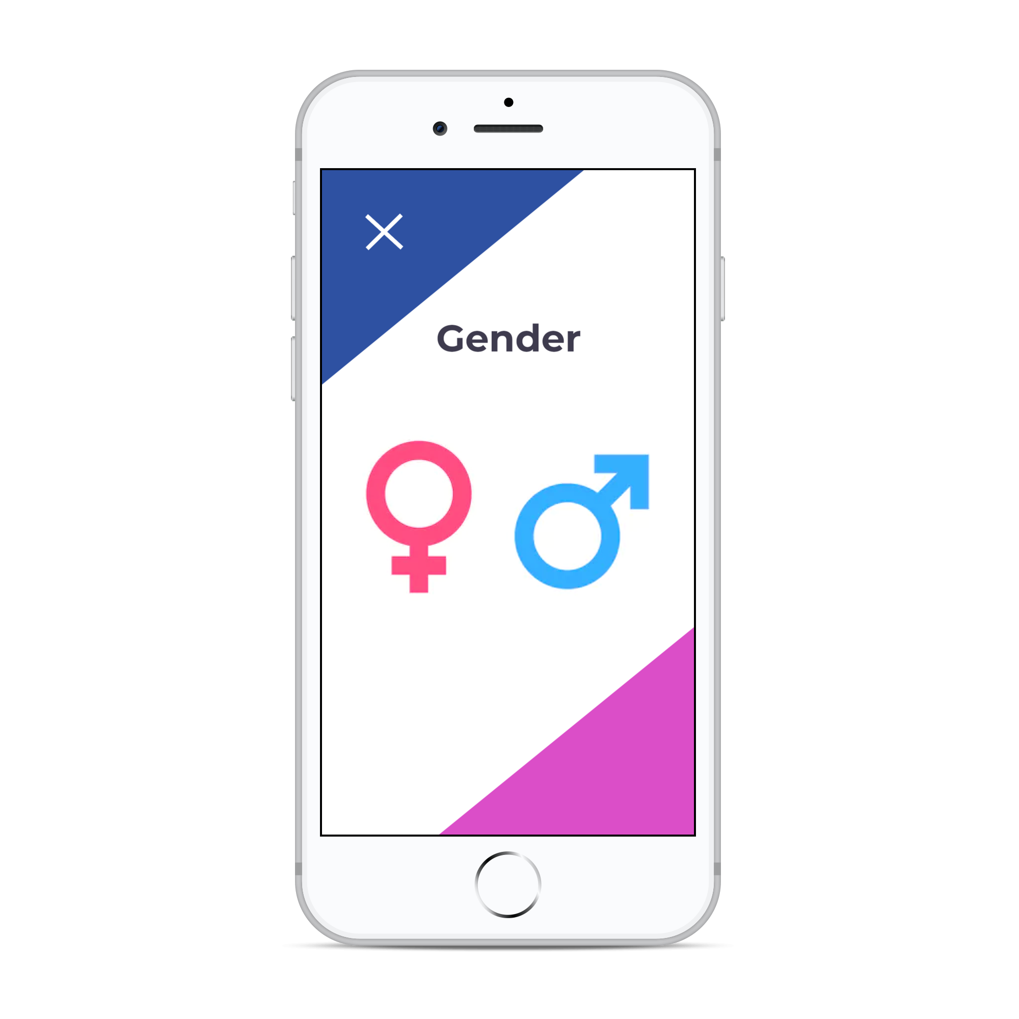
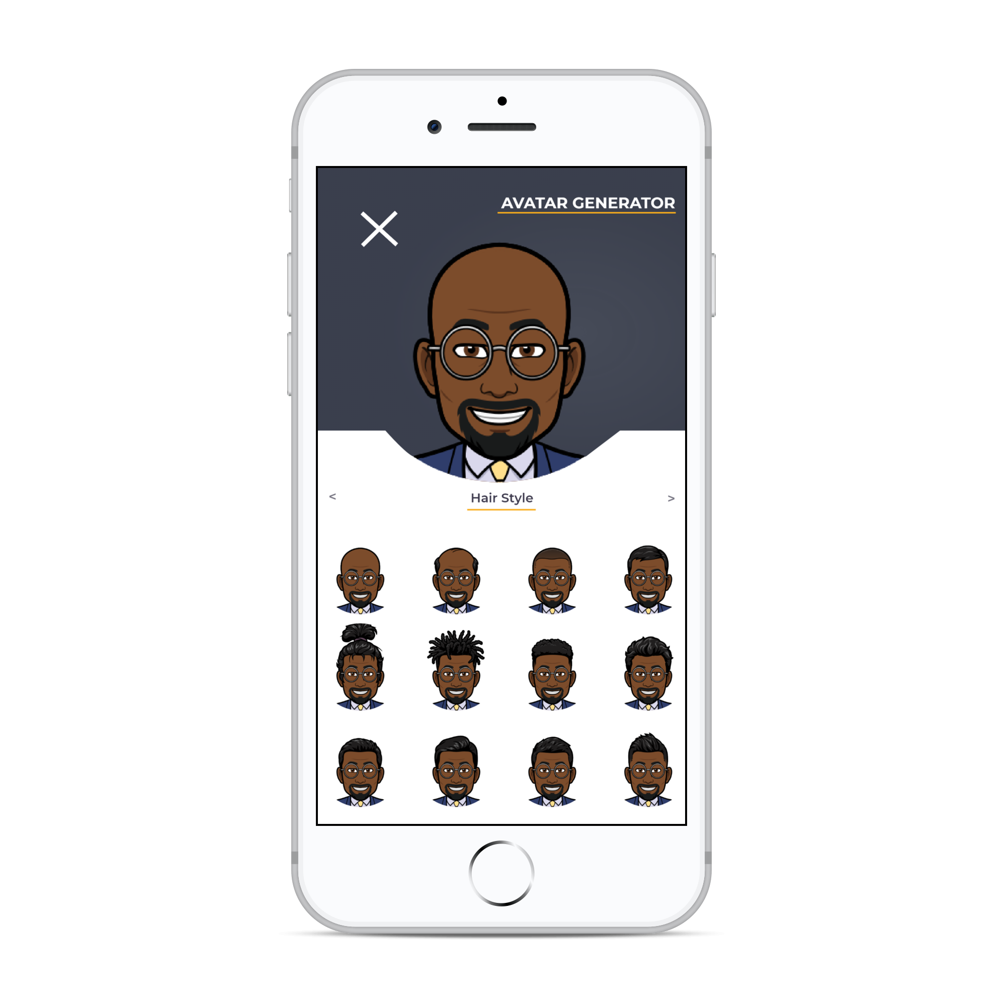
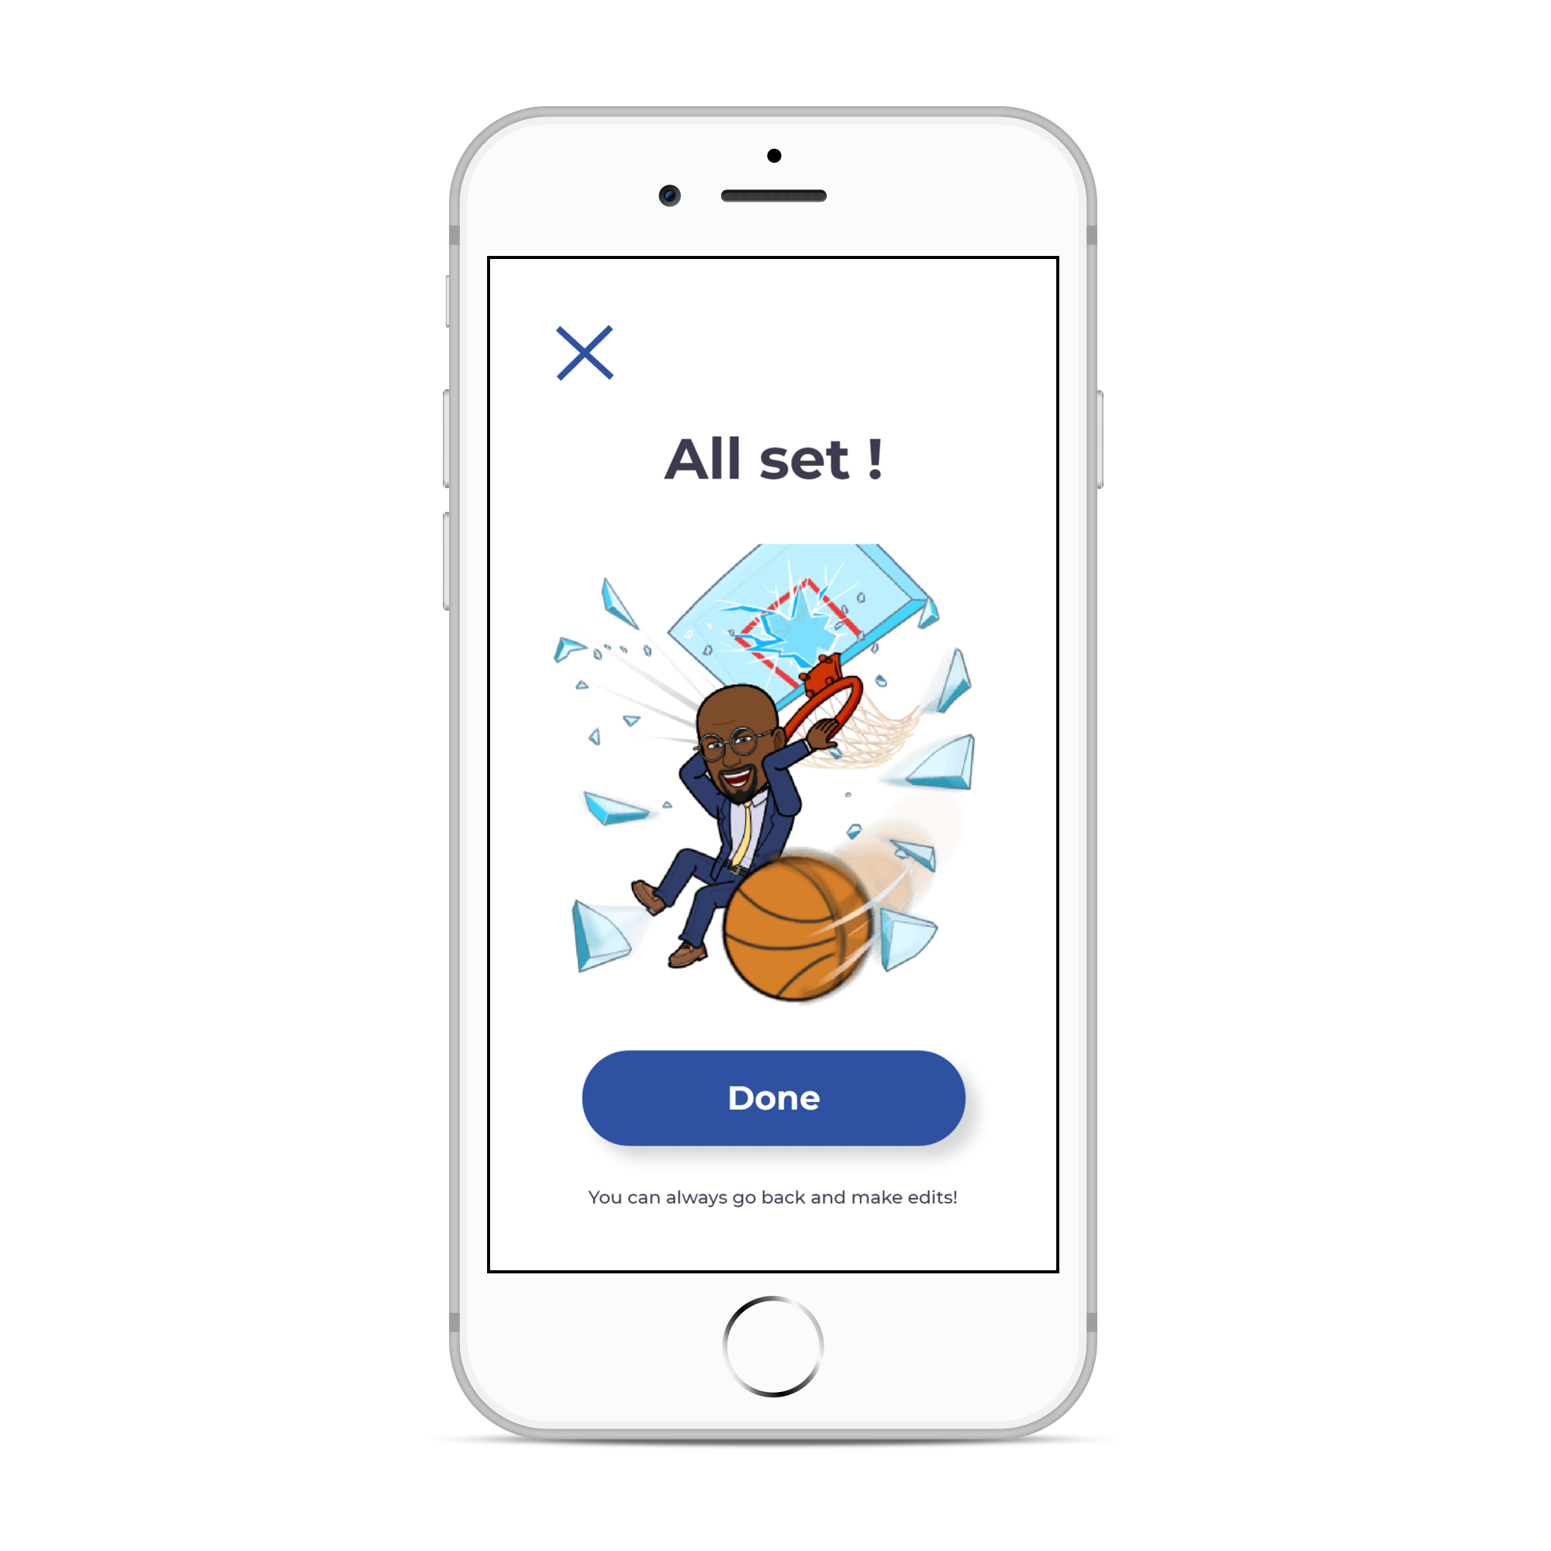
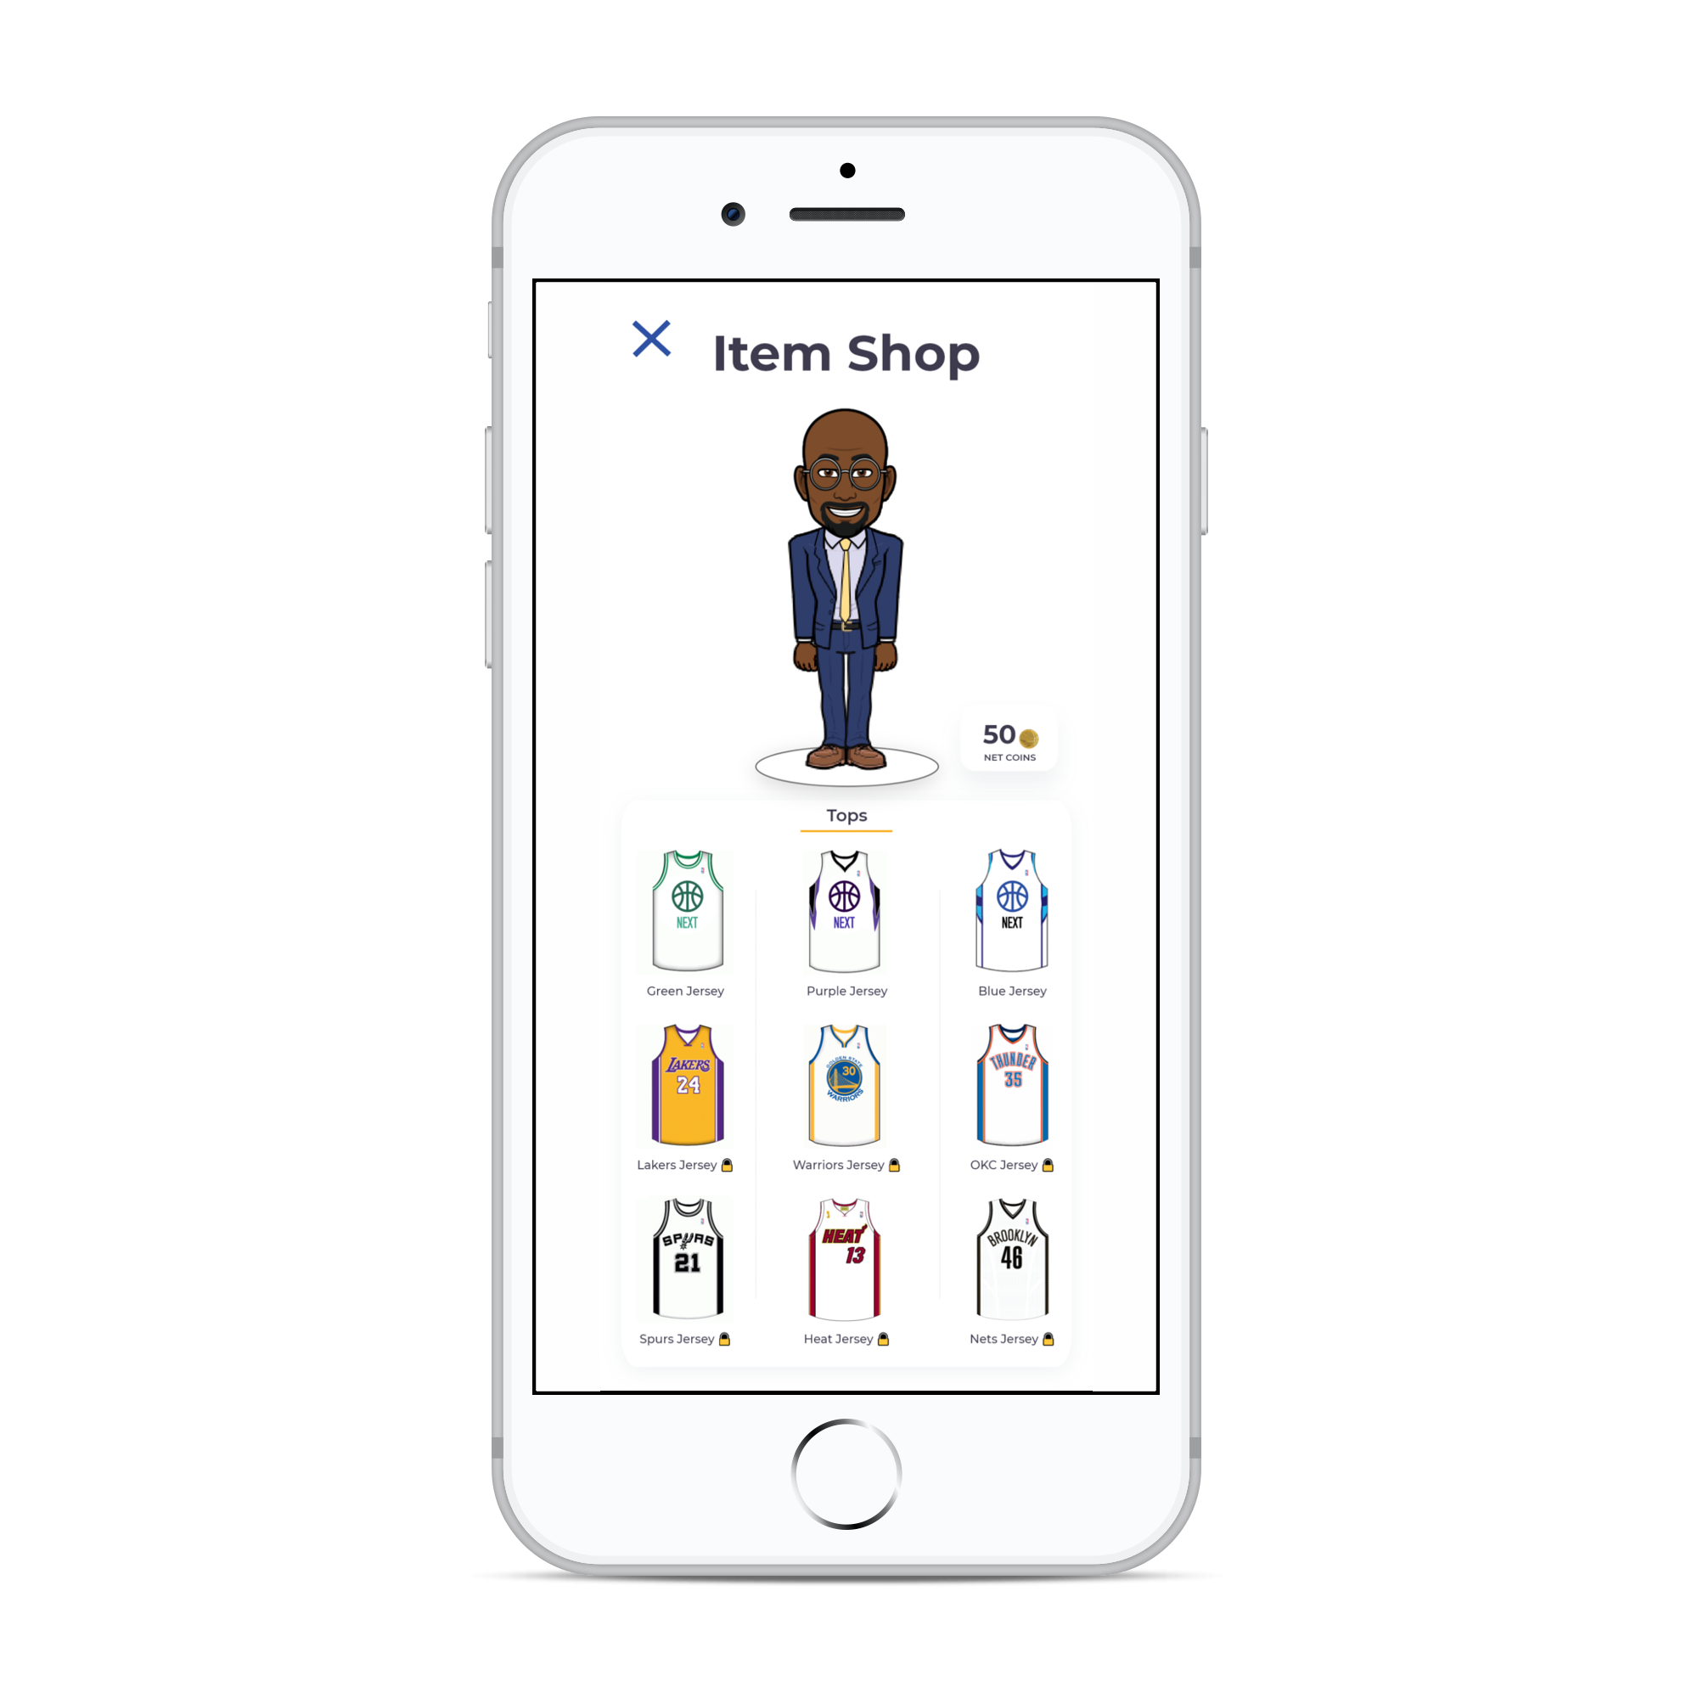
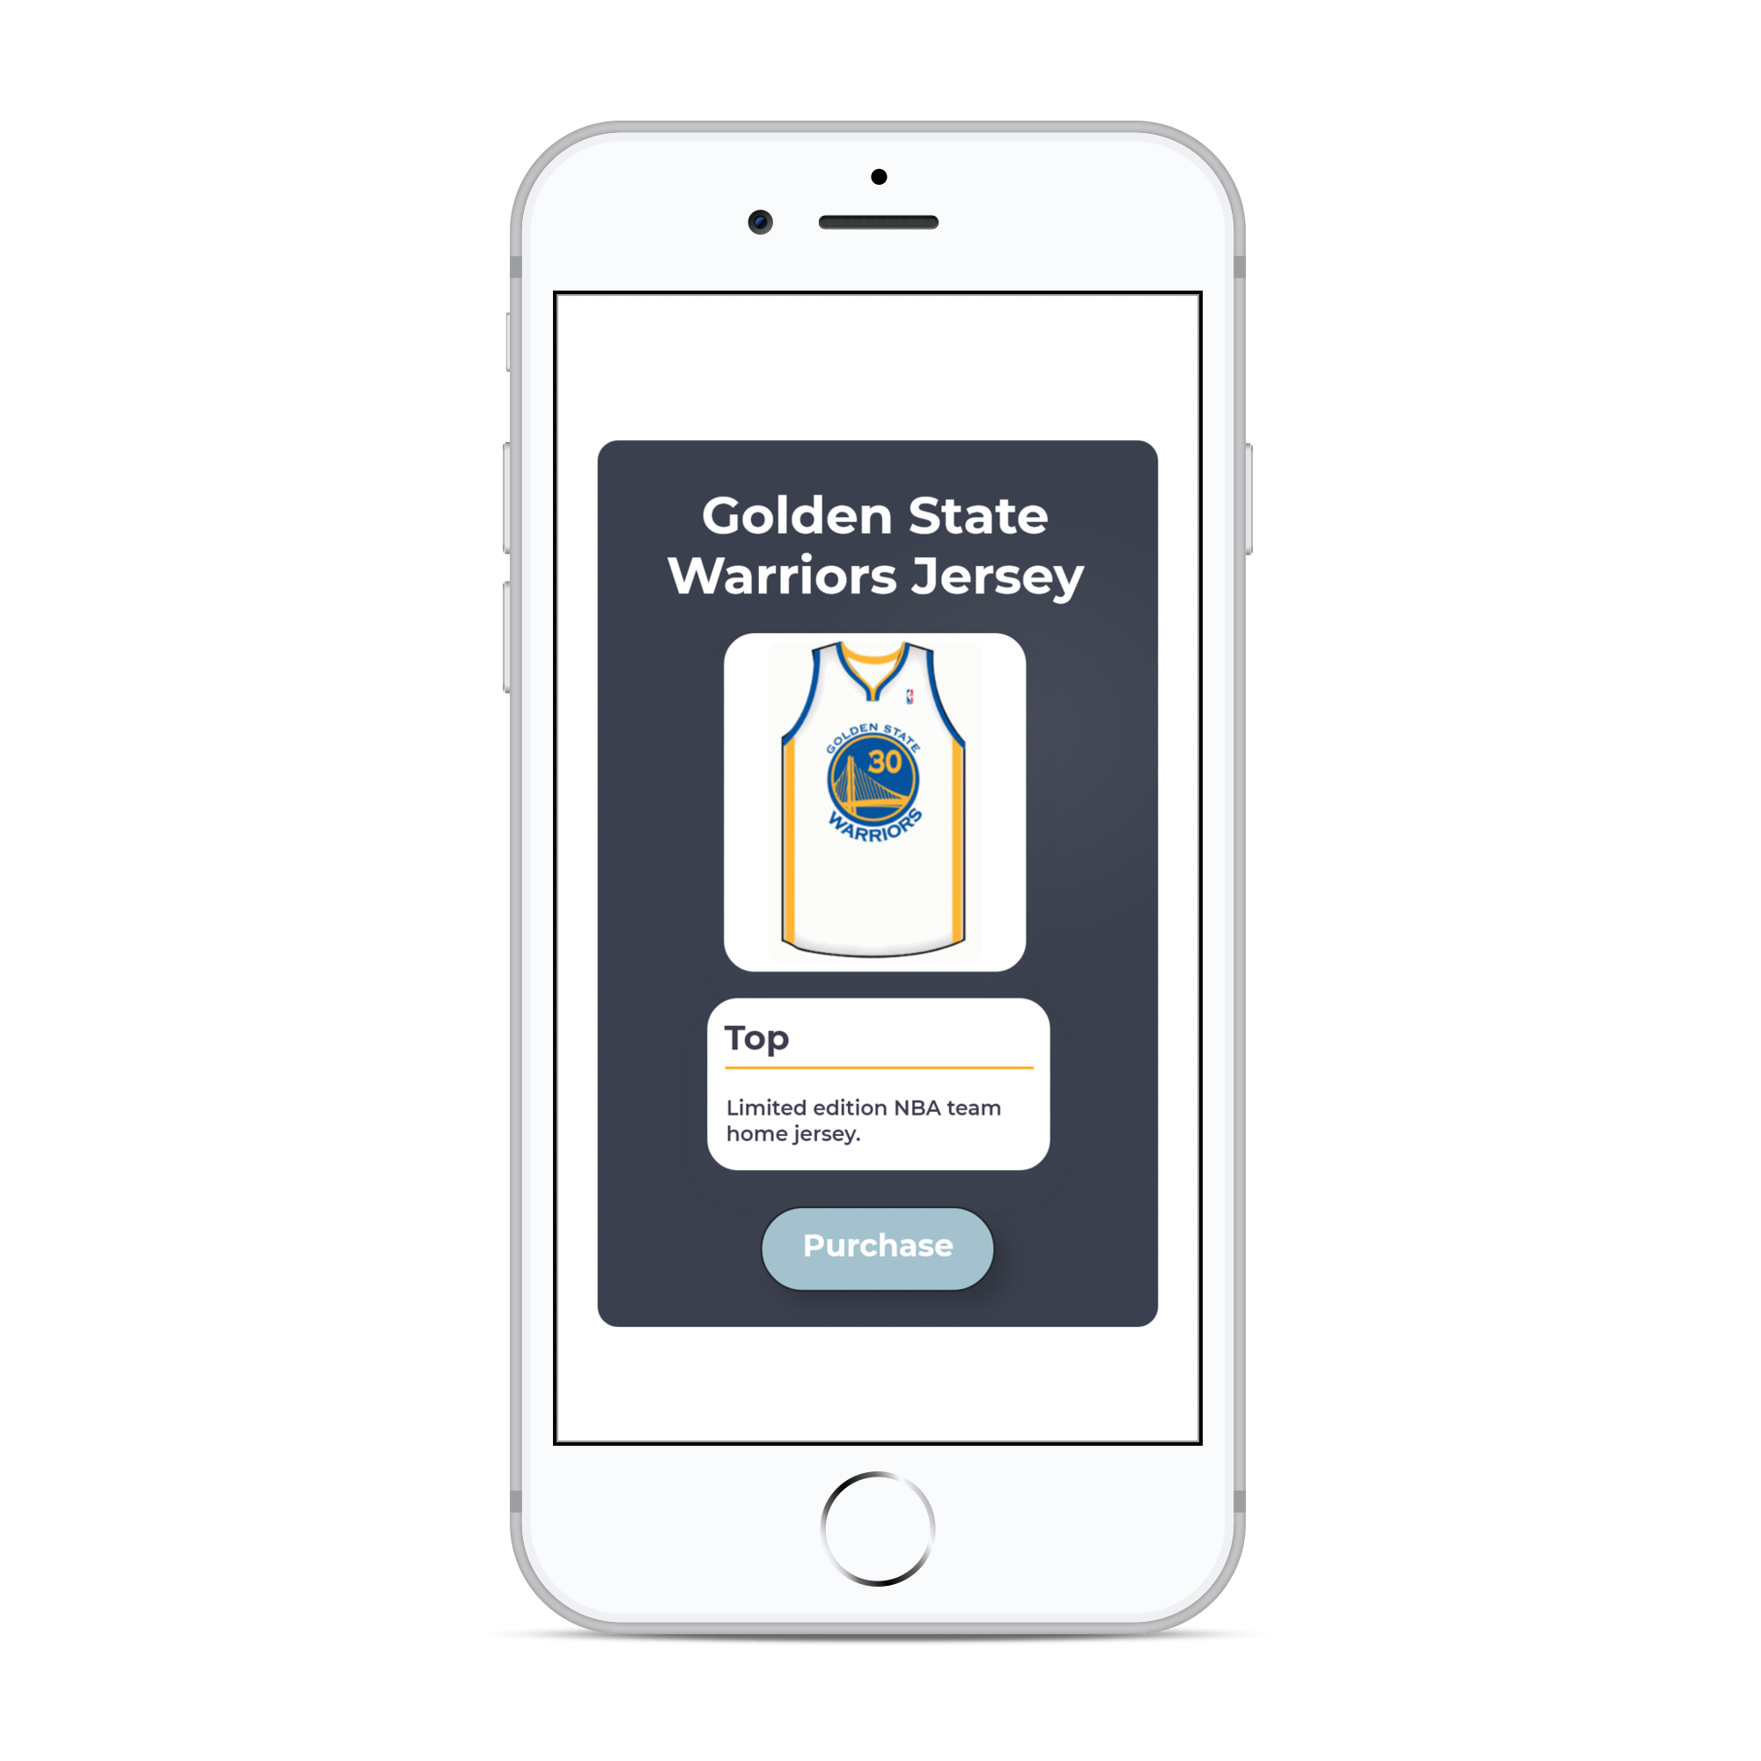
Live Basketball Updates
Instant Messaging
Stay updated with NEXT’s live feed. Live feed consists of posts from various professional basketball associations’, organizations’, and players’ social media.
A built-in instant messaging service allows users to communicate with friends easily without ever having to leave the app.
Navigation
Custom Avatar
Navigate from home, work, or wherever using NEXT’s built-in navigation service; allowing users to navigate to basketball courts without ever leaving the app.
NEXT allows users to create a personal avatar that is displayed when meeting and playing with other players. Avatars are fully customizable from eye colors to the color of their jersey.

Slide 16
$33
billion
Mobile App
$37
billion
In-app
Purchases
Revenue
$58
per iPhone
Average
Advertising
Revenue
Amount
Spent
// NEXT
App
Monetization
US mobile app advertising revenues in 2017 was $33 billion
Worldwide In-app purchase revenues in 2017 was $37 billion
Average amount spent per active iPhone is $58
68.8% of Fortnite players have made in-game purchases
Average spending on Fortnite is $84.67
58.9% of all Fortnite purchases were on in-game character outfits
* Sources | Sense Tower, Lendedu, Statista

Slide 17
// NEXT
App
Monetization
US mobile app advertising revenues in 2017 was $33 billion
Worldwide In-app purchase revenues in 2017 was $37 billion
Average amount spent per active iPhone is $58
68.8% of Fortnite players have made in-game purchases
Average spending on Fortnite is $84.67
58.9% of all Fortnite purchases were on in-game character outfits
* Sources | Sense Tower, Lendedu, Statista

Slide 18




// NEXT
Future
Updates
Live Stories
Set Difficulty
Live stories will allow users to share pictures and videos during their time at basketball courts. Content will be filtered and monitored to ensure appropriate material.
With set difficulties, the app will calibrate and tune to the user’s set difficultly and then suggest and recommend only certain courts and players. Difficulty will based on height, age, and other factors. Users will always have the option to change the difficulty.
Different Sports
Request Features
Determined to expand NEXT to be available for other sports, such as soccer and tennis. Added sports will have their own dedicated mobile app.
Please feel free to leave additional ideas and feedback! Constructive criticism is dearly appreciated, as it allows me to improve.
Email: faisal.hossain75@gmail.com
LinkedIn: faisalhossain75

Slide 19

// NEXT
Credits
Special thanks to All Star Code who made this all possible for me. Within 6 days, All Star Code made by idea into reality by providing the necessary training, equipment, and support!

